Slide 1

Project on HIGH CLOUD AIRLINE ANALYTICS..
Group no : 03
KARTHIK
LAXMI SHARMA
MALATHI PONNAGANTI
ISHAN KS.

Slide 2
SUMMARY :-
HIGH CLOUD AIRLINE ANALYSIS
KPI LIST
EXCEL
POWER BI
TABLEAU
MY SQL
FOCUS ANALYSIS
CHALLEGES

Slide 3
HIGH CLOUD AIRLINE ANALYSIS
The High Cloud Airline Dashboard presents a snapshot of global airline operations, covering 181 airlines across nearly 16,000 cities in 97 countries. A total of 187 million passengers traveled 68 million miles. Southwest and Delta Airlines lead in passenger volume. Weekday flights dominate at 85.6%, with weekends at 14.4%. Major travel routes include Chicago, Washington, Charlotte, and Atlanta. States like Texas, Florida, and New York cover the most distance. The dashboard highlights key metrics such as flight distribution, top-performing carriers, and route efficiency, offering valuable insights for strategic decision-making in the airline industry.

Slide 4
KPI List :-
1.calcuate the following fields from the YearMonth (#) Day fields (First Create a Date Field from Year, Month ,Day fields)"
A. Year
B. Month no
C. Month full name
D. Quarter (Q1,Q2,Q3,Q4)
E. Year Month ( YYYY-MMM)
F. Weekday no
G. Weekday name
H. Financial Month
I. Financial Quarter
2. Find the load Factor percentage on a yearly , Quarterly , Monthly basis ( Transported passengers / Available seats)
3. Find the load Factor percentage on a Carrier Name basis ( Transported passengers / Available seats)
4. Identify Top 10 Carrier Names based passengers preference
5. Display top Routes ( from-to City) based on Number of Flights
6. Identify the how much load factor is occupied on Weekend vs Weekdays.
7. Identify number of flights based on Distance group
8. Build a Dashboard to support your Analysis
9. Create a Dashboard for all above KPI
10. Use the filter to provide a search capability to find the flights between Source Country, Source State, Source City to Destination Country , Destination State, Destination City

Slide 5
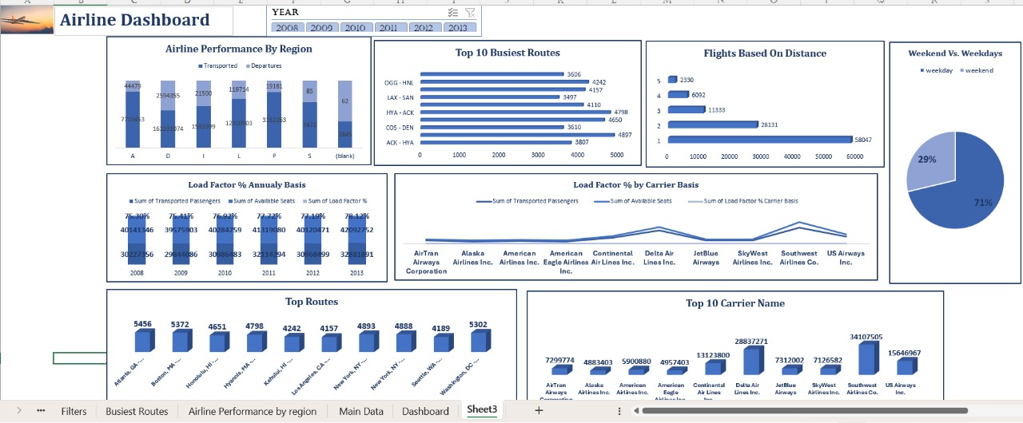
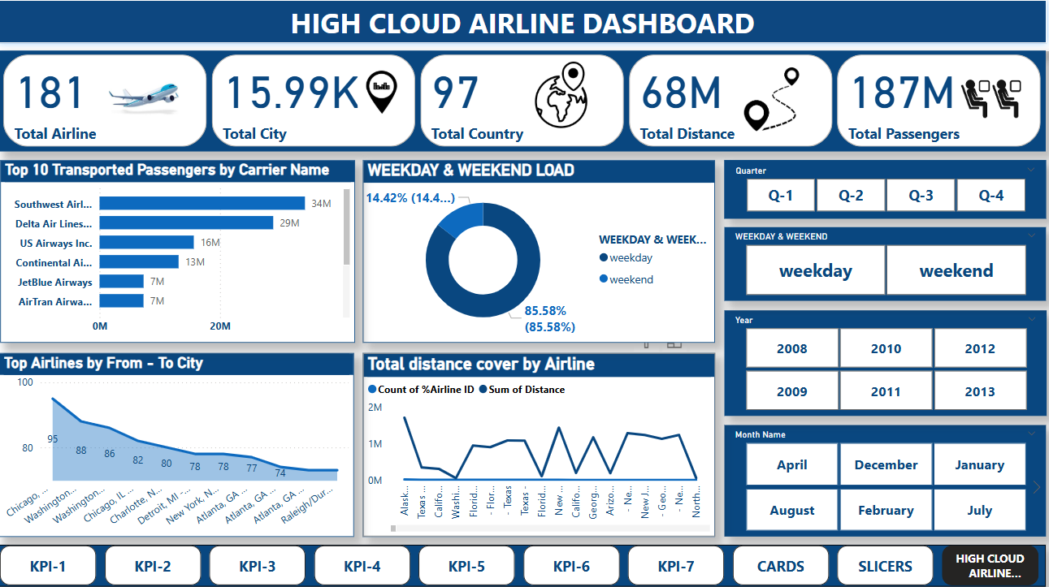
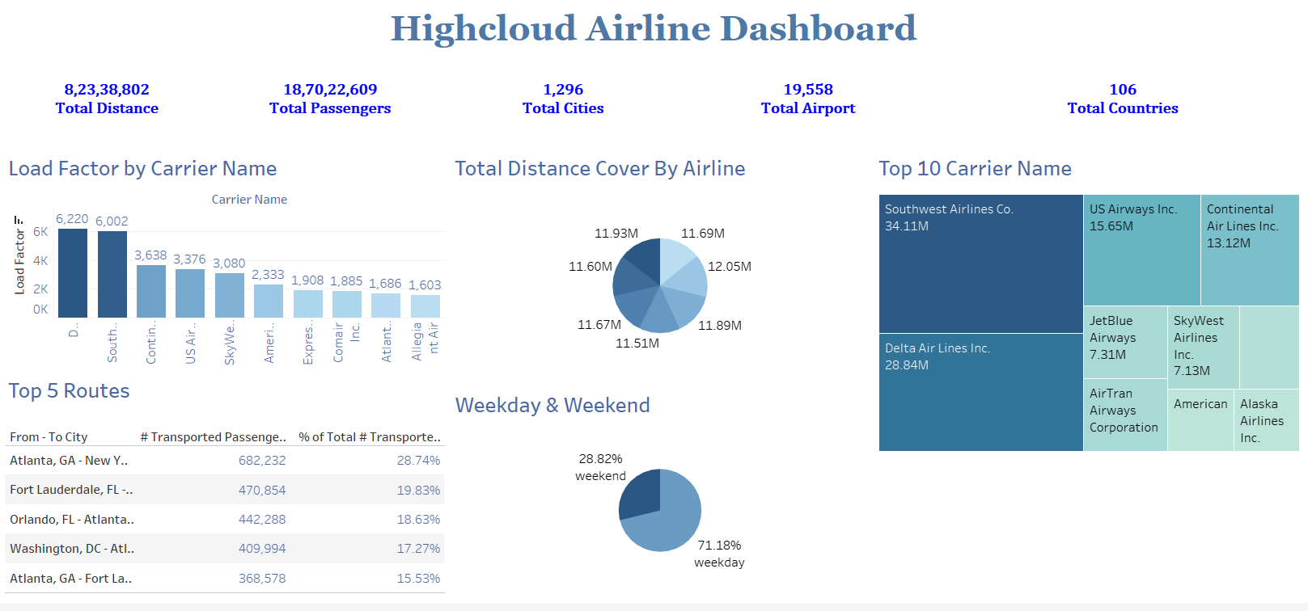
DASHBOARDs

Slide 6
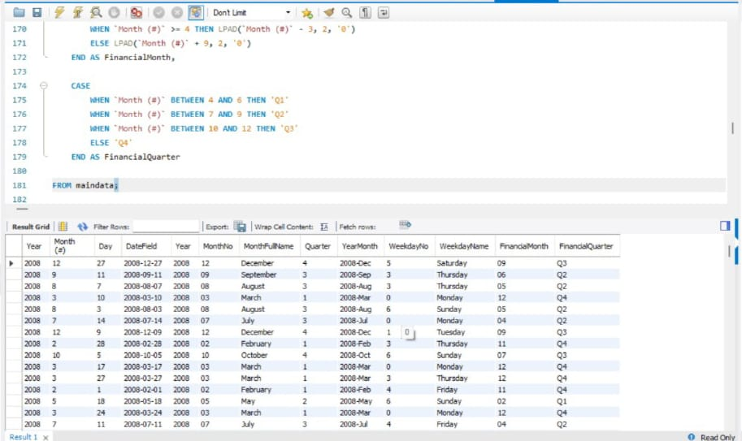
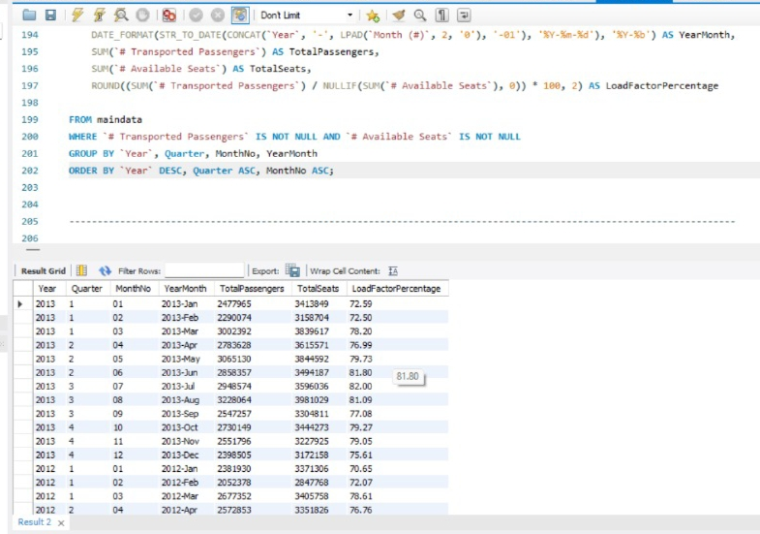
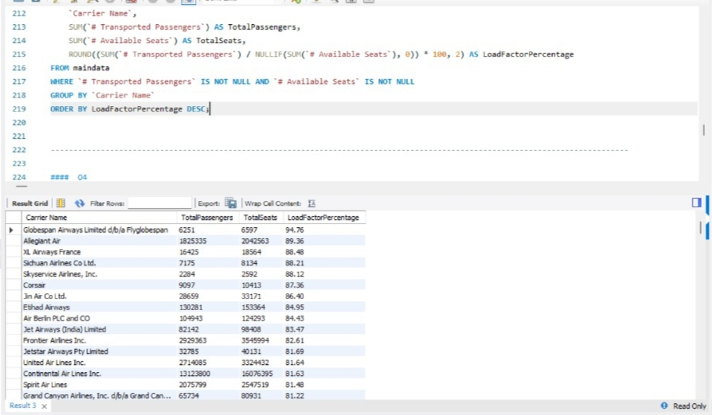
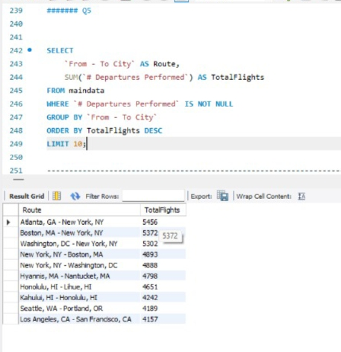
SQL QUERY

Slide 7
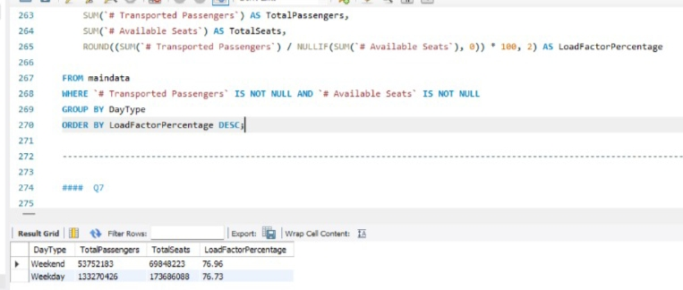
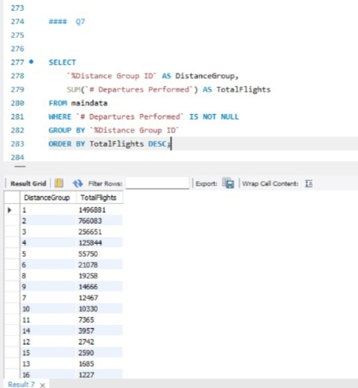
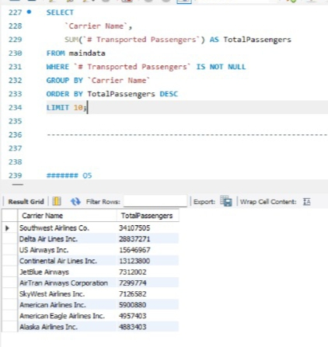

Slide 8
FOCUS ANALYSIS :-
extensive global presence
strong route saturation
cross-border partnerships
underserved regions or redundant overlaps
brand dominance
pricing strategy shifts
crew scheduling
reallocating fleet
campaign targeting
leisure travel promotions

Slide 9
CHALLEGES
Formula Errors: Complex formulas (VLOOKUP, INDEX-MATCH, Power Query) lead to errors.
DAX Complexity: Writing complex DAX formulas for advanced analytics.
Performance Optimization: Extract vs Live Connection issues with large datasets.
Performance Optimization: Writing efficient queries for large datasets.
Indexing & Partitioning: Required to speed up query execution.

Slide 10
Thank you

